Slide 1
Offering an Introductory Linguistics Course in High School
Latin and Linguistics Workshop
Stony Brook University
October 13, 2017
Darienne B. Driver, Ed.D., Superintendent of Schools
Tonya Adair, Chief of Innovation & Information
Suzanne Loosen, Department of Innovation Development
Notes:
Hello! My name is Suzi Loosen, and I am excited to share my experiences teaching an introductory linguistics elective to high school students over the past seven years and explaining how what started as an idea and then a brainstorm and then an email flurry and then a lot of reading and a lot of writing became a thesis project that became a reality in my classroom.

Slide 2

What I Did
Notes:
Since the 2010-2011 school year, I have taught 221 students in seven sections of tenth through twelfth graders in my semester-long, introductory high school Linguistics classes in Milwaukee, Wisconsin.
In this presentation, I will summarize the process of getting the course approved, topics I have covered in the class, resources I have used, things that have gone well with the program, things that haven’t, and what is happening moving forward.

Slide 3

How I Did It
Notes:
In 2009, I designed the class for my Master’s degree in English with a focus on Language and Linguistics at University of Wisconsin - Milwaukee. I then worked with the Milwaukee Public School’s English Language Arts curriculum specialist to write the course code approval document. The course was approved by the School Board in January 2010 – I started teaching the class the following school year.

Slide 4
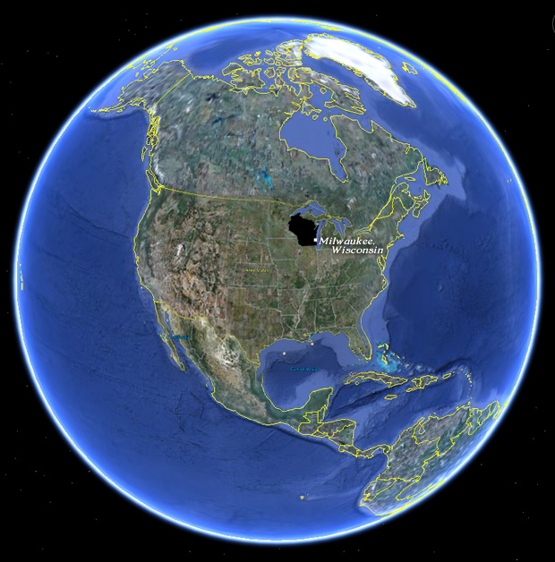
Where I Did It
Notes:
I taught high school English at the Milwaukee School of Languages from 2003-2016. The school is a public, urban 6-12th grade language immersion school. It is ethnically, economically, and linguistically diverse. More than half of the students have studied a second language formally since they entered school at age four and the rest started at age 11 or 12.

Slide 5

Why I Did It
Notes:
My goal ten years ago became to teach my students about what linguists study. When I was in grad school, I would share what I was learning about linguistics with my students and they were enthusiastic, saying, “Why can’t we study stuff like this in school?” And, why not? Of course they could!
Our major units of study in the course have been an introduction to linguistics, the topic of endangered languages, phonetics, morphology, language acquisition, sociolinguistics, and the history of English.

Slide 6

We Study
Notes:
My hook for the class on Day One is teaching students to write in the International Phonetic Alphabet. We discuss prescriptivism and descriptivism and address myths about language. We talk daily about what we observe about language ourselves. We discuss body language, sign language, and animal communication.

Slide 7
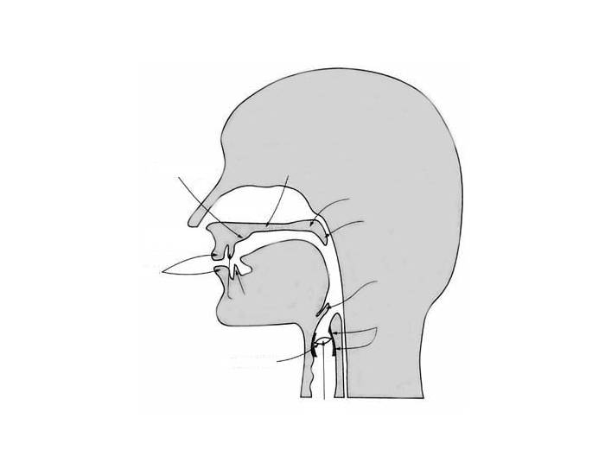
We Study
Notes:
We break down words into their morphemes. We analyze data sets from past North American Computational Linguistics Olympiads. We study vocal anatomy and practice with the University of Iowa Phonetics website.

Slide 8

We Study
Notes:
We write about our own observation of the language of a child under age four. We conduct surveys of people’s perceptions of different dialects, study regional dialects, genderlects, and talk about slang, jargon, taboo, and euphemisms. We contrast varieties of British and American English. We study etymology. We complete exercises on language change. We vote for our own Word of the Year.

Slide 9

Our Textbooks
Notes:
Because a high school level textbook does not yet exist, I use the Power Points that accompanied the eighth edition to Fromkin, Rodman, and Hyam’s An Introduction to Language, excerpts from Denham and Lobeck’s Linguistics for Everyone, as well as essays from Language Awareness: Readings for College Writers.

Slide 10

We Watch
Notes:
We watch the documentaries The Linguists, The Secrets of Body Language, and the Do You Speak American? series. Online videos include TED-Ed videos relating to language, TED Talks about language acquisition by Deb Roy and Patricia Kuhl, and talks relating to language by John Green on Mental Floss.

Slide 11

We Observe Language
Notes:
Each week, students create a log of recent observations about language. They become keen observers of what is said in the hall, on the bus, at their workplaces, in their kitchens, and online. We start several classes a week by addressing student observations or questions. We talk about this being a key piece of the scientific method - paying attention to what is occurring in your surroundings and asking ‘why?’ ‘how?’ and ‘under what conditions?’

Slide 12
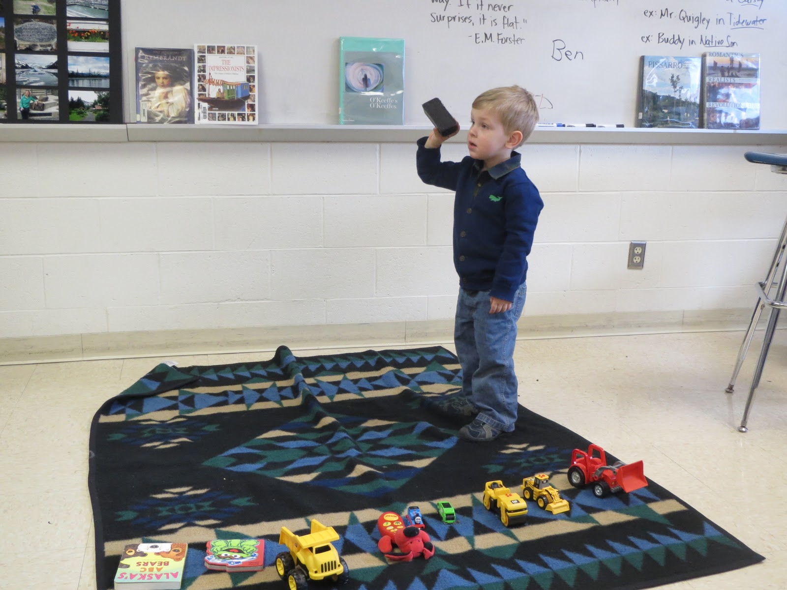
Our Guest Speakers
Notes:
Popular guest speakers have included: A professor of Ojibwe from UW-Milwaukee, a parent and a psychologist fluent in American Sign Language, a school speech pathologist, sociolinguists from UW-Madison, a deejay who came in to talk about censorship, a linguist from New Mexico who joined us virtually, a local linguist who came in to do charcoal palatograms with us, and my sons who have come in as examples of the stages of language acquisition.

Slide 13
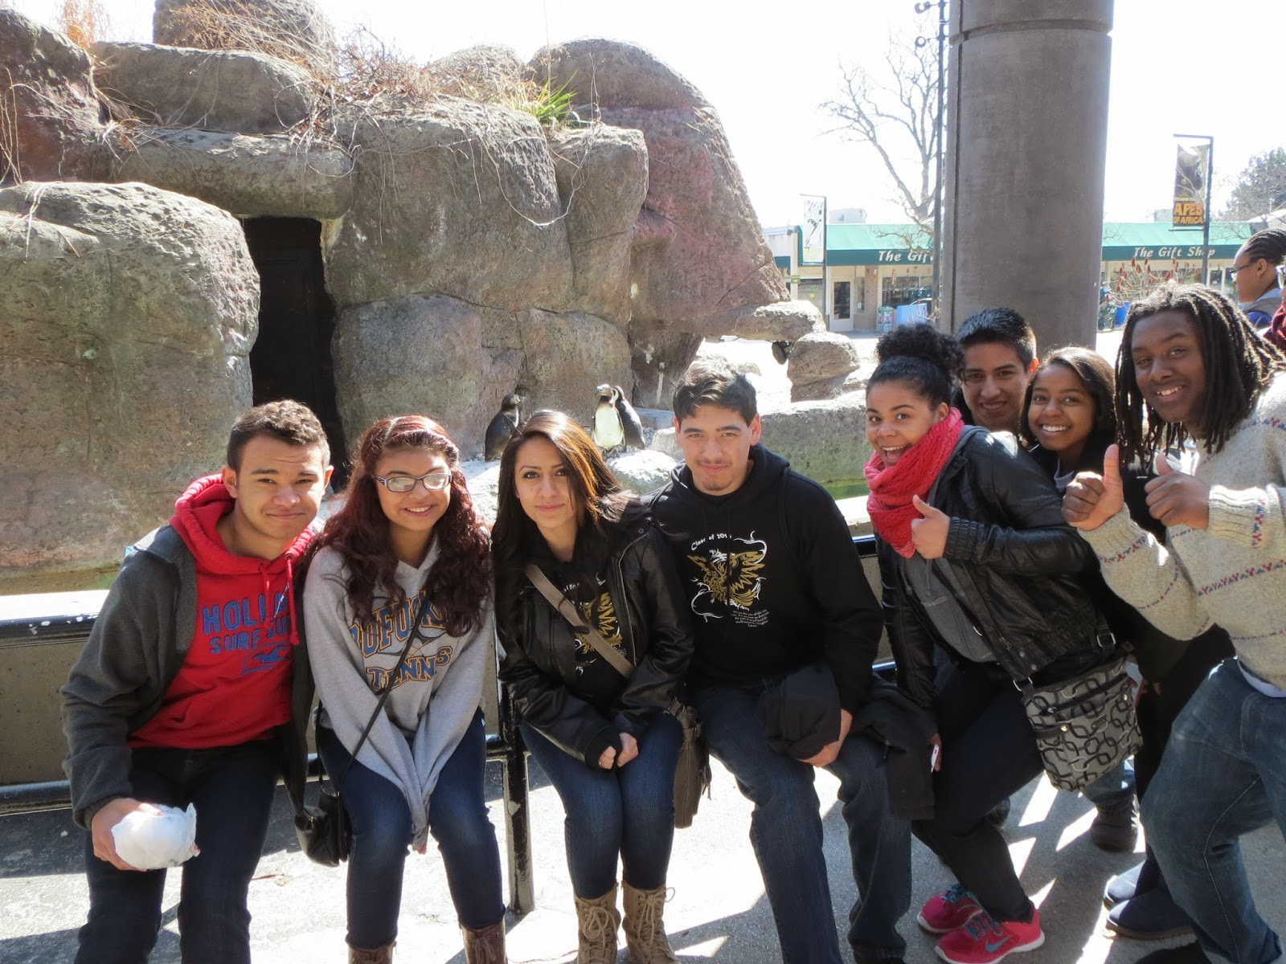
What Went Well
Notes:
Students connect what they’re learning in Linguistics to their Psychology, History, Science, and World Language classes. I have heard from parents at conferences that students are talking about the class and content at home. I’ve had students come running to my room between classes because they were so excited to share something that they had observed about language.

Slide 14

What Went Well
Notes:
Our Pidgin Dinner Parties have been major highlights. Students share a meal seated next to peers who do not speak the same second language that they do and have to share a meal without speaking English so that a pidgin language forms. It was students who came up with the idea my first time teaching the course after I had a small group figure out how to share a granola bar without using any English.

Slide 15

What Didn’t Go Well
Notes:
I am an English teacher, not a linguist, so I present myself to students as a fellow student of linguistics who still has much to learn. I find that a challenge is that many students don’t know what linguistics is in the first place, so marketing the class is key. Another challenge is the mix of reading levels amongst my high school students which vary from elementary through college levels.

Slide 16
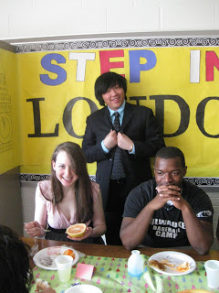
What the Students Said
Notes:
My student Corey said, “I surely won’t be able to just have a conversation without thinking of a possible language observation coming to mind. It’s made me appreciate the ability my mouth and body have to express who I am and what I am feeling.” Skylyn called the class “eye-opening” and noted that the class requires that students “consider the language and speaking styles of other communities, countries, and peoples.”

Slide 17
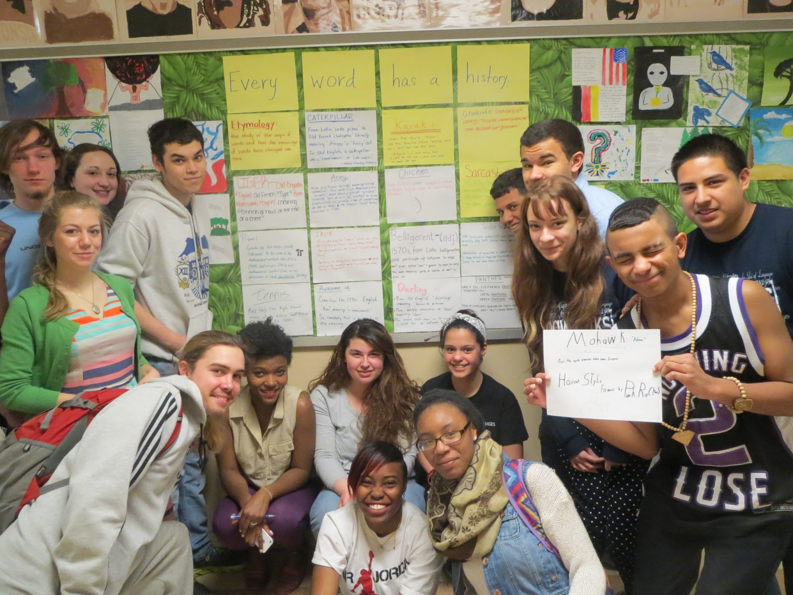
What the Students Said
Notes:
Eric said, “It comes as a surprise to me that this is not a mandatory class or even that most people aren’t even offered a chance to take linguistics.” Valentin said: “Linguistics has made me more interested in learning new languages and has also made it easier than before. Language is so important because it’s like a key to the world. Everybody should know about linguistics, and I for myself, cannot get enough of it.”

Slide 18

Where This Is Going
Notes:
As we all know here, Richard Larson has established an LSA Committee on the creation of an Advanced Placement Linguistics course. The goal is to develop a curriculum and an exam in the next five to seven years and to get an initial 250 high schools on board to offer the course. This class has the potential to open up the world of linguistics to thousands of students in high school.

Slide 19
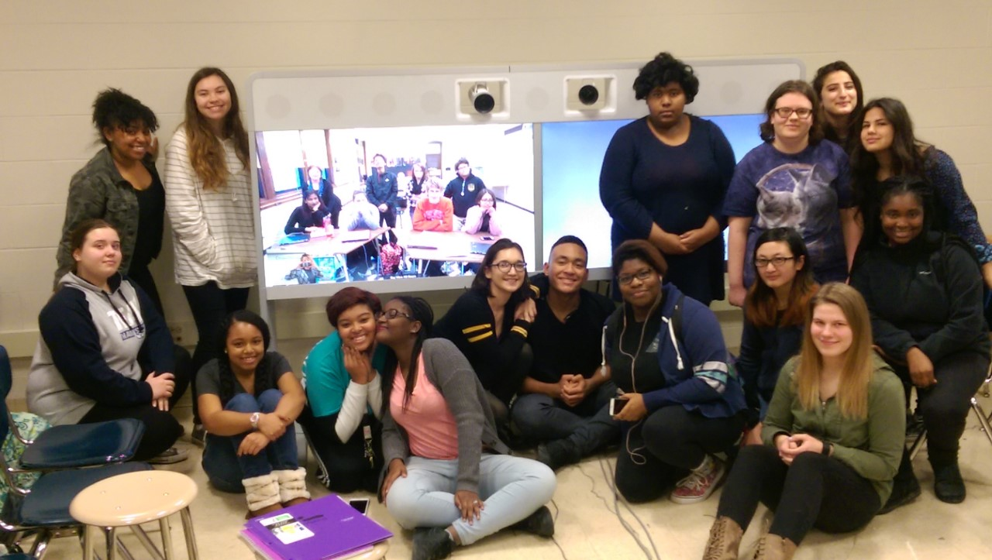
My Current Position
Notes:
My current position in Milwaukee Public Schools is as the Telepresence Teacher Leader in the Department of Innovation.
Last year second semester I taught Linguistics through telepresence to 24 students at two high schools in Milwaukee and I am scheduled to do the same this school year, supporting district goals aligned to Equity and Culturally Responsive Teaching.

Slide 20
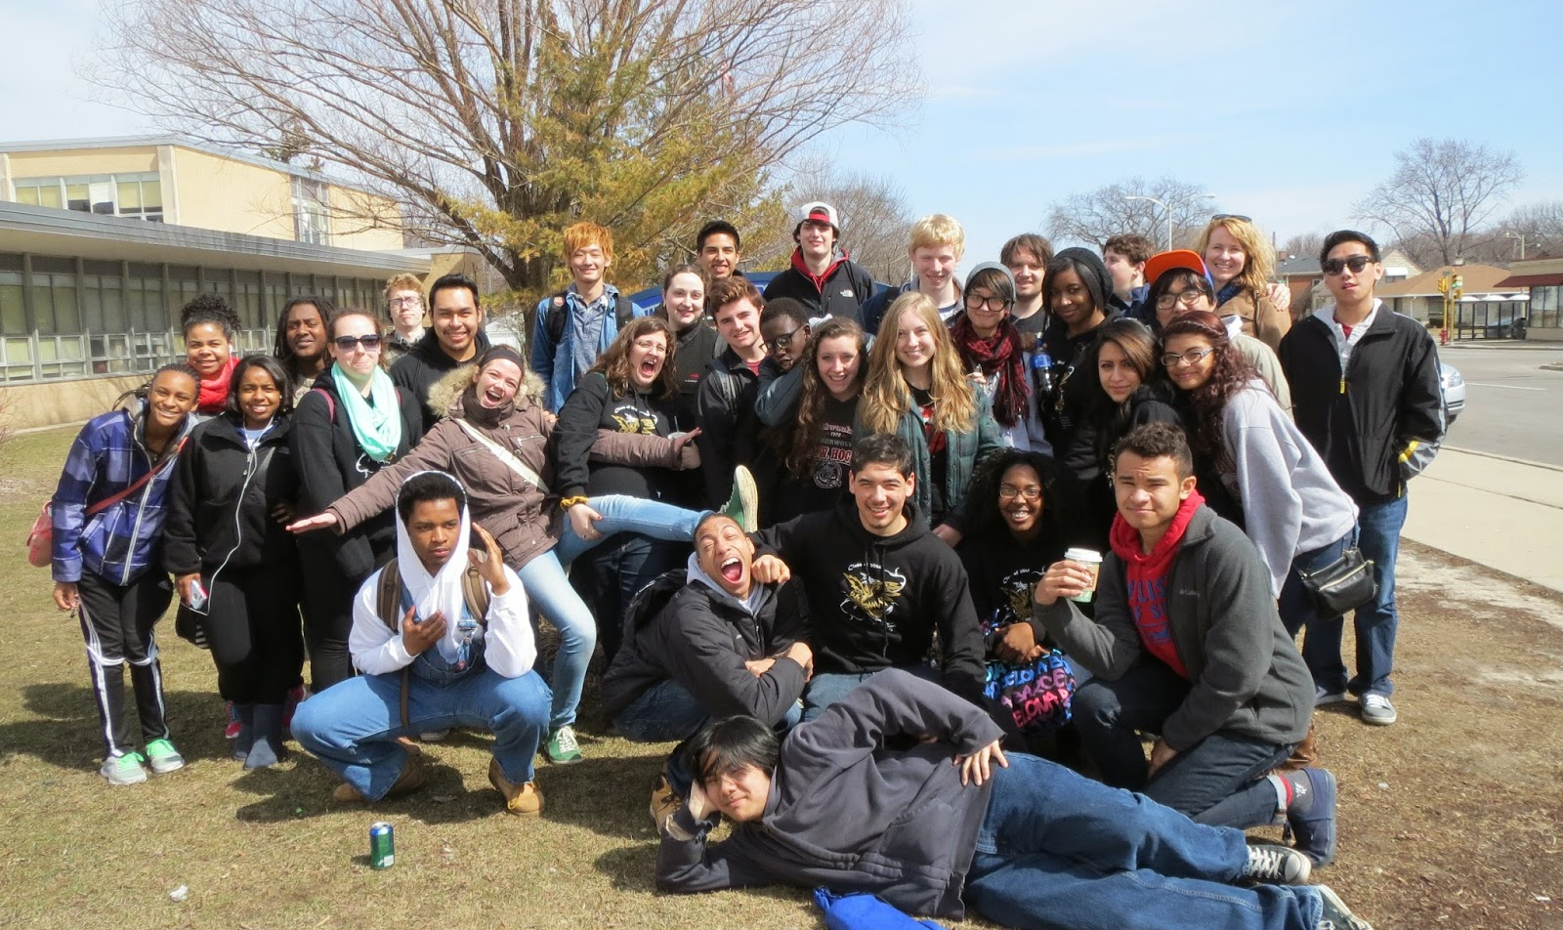
Why I Am Excited to Be a Part of This
Notes:
Now more than ever, it is clear that we need to help students to understand and respect the nuances of language, to help them to pay attention, to ask “Why?,” to facilitate civil debate and mutual understanding.
In conclusion, a student once told me that “This class opened my ears.”

Slide 21
To Read More
Loosen, S. (2014). High school linguistics: A secondary school elective course. Language, 90:4, e258-e273. https://muse.jhu.edu/article/563098/summary
IMAGE CITATIONS:
@bldngblockssll. Baby. Digital image. Building Blocks Speech, Language & Literacy. N.p., 01 Oct. 2015. Web. 21 Dec. 2016.
"Building+blocks - Google Search." Building+blocks - Google Search. AdvisorAnalyst, n.d. Web. 21 Dec. 2016.
Cautionfilm. "Medium Long Shot of Two Climbers Arriving a Snow-covered Mountain..."Getty Images. Cautionfilm, n.d. Web. 21 Dec. 2016.
Man pushing rock. Digital image. N.p., n.d. Web. 3 Dec. 2016.
Milwaukee on Map of the World. Digital image. N.p., Oct. 2010. Web. 3 Dec. 2016. Open book. Digital image. N.p., n.d. Web. 3 Dec. 2016.
Organs of Speech. Digital image. Image Quiz, n.d. Web. 27 Dec. 2016.
Question mark. Digital image. Clipart, n.d. Web. 3 Dec. 2016.
The Linguists documentary photo. Digital image. NVCC, 7 Apr. 2014. Web. 11 Dec. 2016.
Two people in conversation. Digital image. Voices in Wartime, n.d. Web. 2 Jan. 2017.

Slide 22
Offering an Introductory Linguistics Course in High School
Milwaukee Board of School Directors MPS Senior Team
Mark Sain, District 1, President
Larry Miller, District 5, Vice President
Wendell J. Harris, Sr., District 2
Michael Bonds, Ph.D., District 3
Annie Woodward, District 4
Luis A. Báez (Tony), Ph.D., District 6
Paula Phillips, District 7
Carol Voss, District 8
Terrence Falk, At-Large
Darienne B. Driver, Ed.D., Superintendent of Schools
Gina Spang, P.E., Chief of Staff
Tonya Adair, Chief Innovation and Information Officer
Ruth Maegli, Chief Academic Officer
Himanshu Parikh, Acting Chief Human Resources Officer
Keith Posley, Ed.D., Chief School Administration Officer
Wendell Willis, Chief Operations Officer
Sue Saller, Manager, Superintendent’s Initiatives
Ashley Lee, Special Assistant to the Superintendent

